Slide 1

KUVEMPU UNIVERSITY
Department of of P.G. Studies & Research in Applied Botany
Project Presentation On:
Preliminary phytochemical screening and in vitro antibacterial activity of stem extract of cissus quadrangularis L
Presented by:
Reg.no: PS202627
Department of Applied Botany,
Kuvempu university, Shankaraghatta.
Project Guide:
Dr. REENA ROY
Lecturer
Department of Applied Botany,
Kuvempu University, Shankaraghatta.

Slide 2
CONTENTS
INTRODUCTION
MEDICINAL PROPERTIES
OBJECTIVES
MATERIALS AND METHODS
RESULTS AND DISCUSSION
CONCLUSION
REFERENCE

Slide 3
Introduction
The plant kingdom has been the best source of remedies for curing a verity of disease and pain.
According to the WHO more than 80% of the world’s population relies on traditional herbal medicine for their primary health care.
In the present era of drug development and in discovery of newer drug, molecules of many plant products are evaluated on the basis of their traditional uses.
Medicinal plants are widely used in non-industrialized societies, mainly because they are readily available and cheaper than modern medicines.
Drug research sometimes makes use of ethnobotany to search for pharmacologically active substances, and this approach has yielded hundreds of useful compounds.
One of the many plants which are being evaluated for their therapeutic efficacies is Cissus quadrangularis which is commonly known as Hadjod (Bengali) and Edible Stemmed Vine (English).
Cissus quadrangularis (Linn) is a succulent perennial climber, scattered all over India is a traditional medicinal plant which shows promising results in joint and bone health.

Slide 4
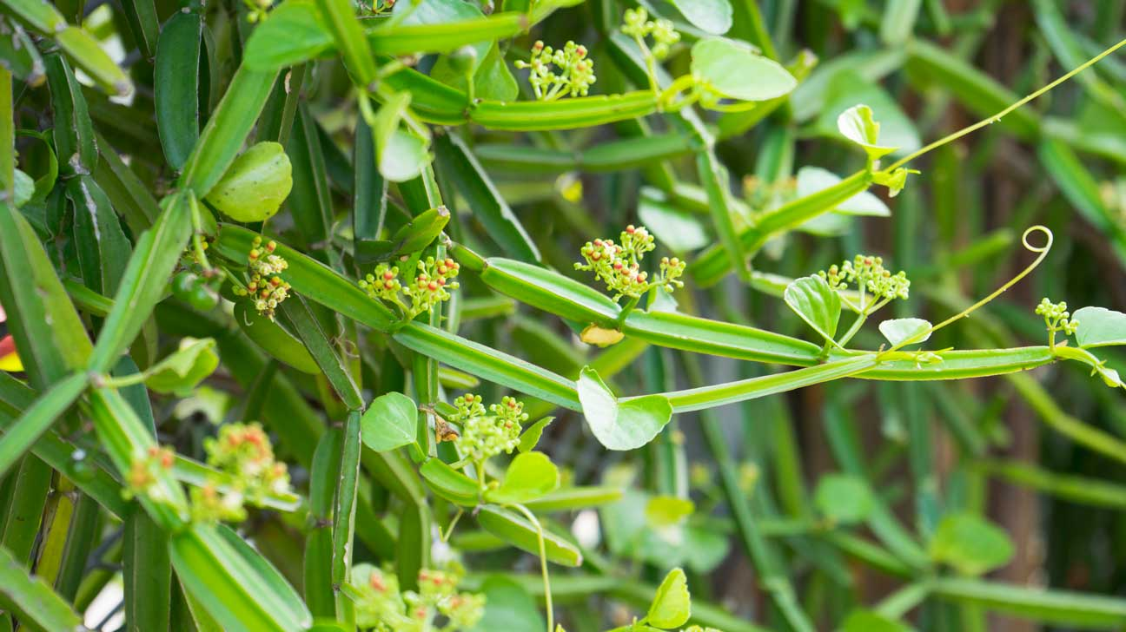
It is commonly known as veldt grape, winged treebine or adamant creeper. The species is native to tropical Asia, the Arabian Peninsula and much of Africa.
The plant is commonly known as Vajravalli in Sanskrit, Hadjod in Hindi, Kandvel in Marathi, Haddjor in Punjabi, Hadbhanga in Oria, Vedhari in Gujrati, Perandi in Tamil, Nalleru in Telugu and Veldgrap, Edible Stemmed Vine in English.
Kingdom : Plantae
Division : Magnoliophyta
Class : Magnoliopsida
Order : Vitales
Family : Vitaceae
Genus : Cissus
Species : quadrangularis Linn.
Cissus quadrangularis has quadrangular stems, small leaves and also roots that all possess medicinal properties as revealed by the surveys and trials conducted by ethno-botanists and traditional herbal healers especially for the treatment of bone fractures and swelling.
The stem is bitter in taste and commonly used as the oral and topical applications in bone fractures, complaints of the back and spine, asthma, heat burns, wounds and insect bites.

Slide 5
Medicinal properties
The whole plant including all parts such as stems, leaves, roots of C. quadrangulari were documented to possess medicinal properties in ethnobotanical surveys conducted by ethnobotanists in traditional system of medicine.
The stem is bitter in taste and commonly used as the oral and topical applications in bone fractures, complaints of the back and spine, asthma, heat burns, wounds and insect bites.
The roots and stems are most useful for healing of fracture of the bones.
The plant has been documented in Ayurveda for the treatment of osteoarthritis, rheumatoid arthritis and osteoporosis. The stem juice of plant is used to treat scurvy and menstrual disorders.
The stout fleshy quadrangular stem is traditionally used for treatment of gastritis constipation, eye diseases, piles and anemia.
This herb is documented to possess a wide-ranging ethnomedicinal uses in malaria, fever, epilepsy, gout, piles and skin diseases.
This herb showed the properties of antibacterial, antimicrobial, antioxidant, activities.

Slide 6
different extracts.of C. quadrangularis Linn (Vitaceae) against some Gram-negative and Gram-positive bacteria showed antibacterial activity .
Anti-bacterial activity of C.quadrangularis was studied against some pathogenic bacteria and In-vitro Anti-cancer activity was screened by MTT assay against MCF cell line. In this study, the secondary metabolites such as phenol, alkaloids, tannins and flavonoids were present in the ethanolic extract of C.quadrangularis.
C. quadrangularis showed the antimicrobial activity and characterizes the chemical constituents of stems of Cissus quadrangularis L. using Gas Chromatography Mass Spectrophotometry (GC-MS). to determine the antimicrobial activity of methanol, ethanol, aqueous and petroleum ether extracts of Cissus quadrangularis stems against avian microorganisms.
cissus quadrangularis showed antibacterial activity against carcinogenic microorganisms against S. mutans and L. acidophilus, but it was not comparable to calcium hydroxide.
Cissus quadrangularis and was tested for antibacterial activity against Bacillus cereus and Bacillus megaterium which subsequently showed zone of inhibition of 21 and 20mm respectively. Cp from C. quadrangularis degraded the peptidoglycan layer of bacteria by Cp was confirmed by transmission electron microscopic analysis.

Slide 7
OBJECTIVES
The study was aimed to evaluate the antifungal potential of Cissus quadrangularis with following objectives:
To extract secondary metabolites from Cissus quadrangularis stem using low and medium polar solvents
To conduct thepreliminary phytochemical analysis from the crude extracts of C. quadrangularis.
To test the antibacterial activity of ethanolic crude extract.

Slide 8
MATERIALS AND METHODOLOGY
COLLECTION OF PLANT MATERIAL
PREPARATION OF CRUDE EXTRACT
FILTERATION OF DIFFERENT SOLVENT EXTRACT
DRYING OF SOLVENT EXTRACT
COLLECTION OF PLANT EXTRACT
PHYTOCHEMICAL ANALYSIS OF CRUDE EXTRACT
PREPARATION OF INOCULUMS PLANT EXTRACT
ANTIBACTERIAL ASSAY OF STEM EXTRACT BY AGAR WELL DIFFUSION METHOD
PLANT MATERIAL IN DIFFERENT SOLVENTS

Slide 9
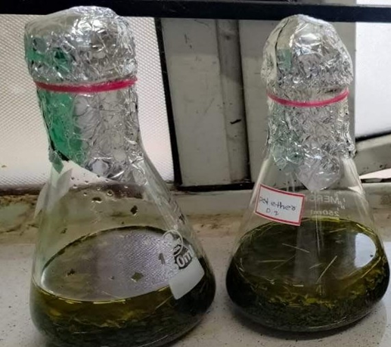
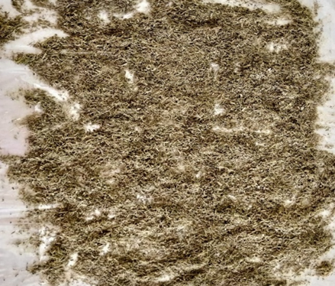
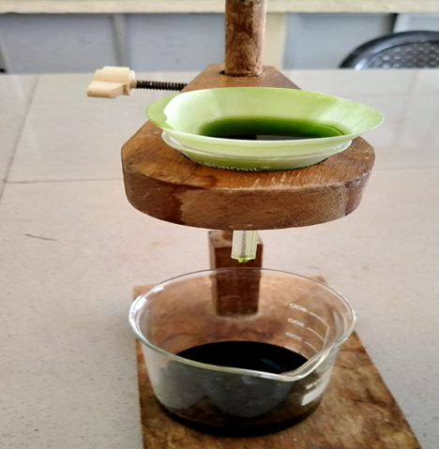
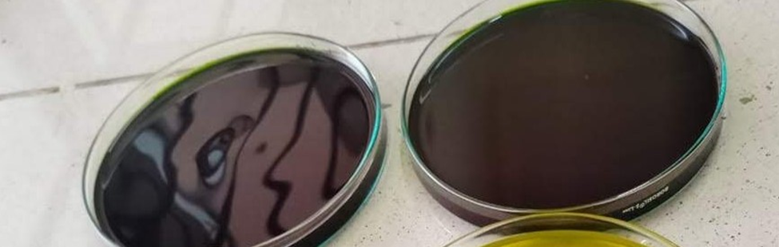
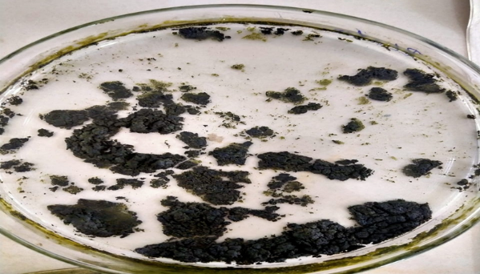
STEPS INVOLVED
fig 1:coarsley powdered plant material fig 2:plant material in different solvents
fig 3:filteration of plant extract fig 4:drying of plant extract fig 5:plant extract

Slide 10
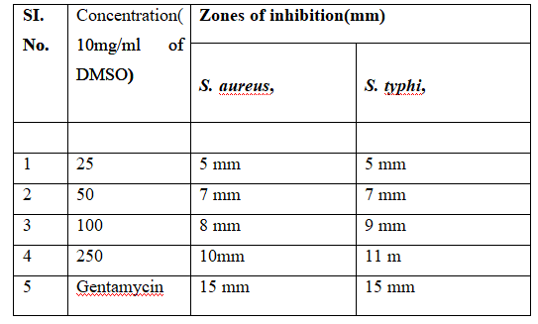
ANTIBACTERIAL ASSAY
The antibacterial activity of ethanolic stem extract of C. quandrangularisagainst the tested bacterial species by agar well diffusion method . The antibacterial activity was confirmed by an inhibition zone absence or presence all over the wells loaded with the extract. The result confirmed that extracts are more sensitive to both gram-positive bacteria and gram-negative bacteria. The extract was found to be effective towards S. aureus and S. typhi with the increase in concentration of the extract as shown in the table.
Antibacterial activity of ethanolic stem extract of C. quandrangularis

Slide 11
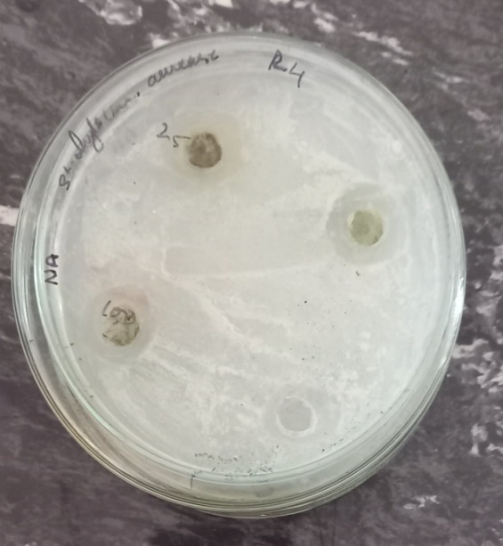
RESULTS AND DISCUSSION
Salmonella aureus

Slide 12
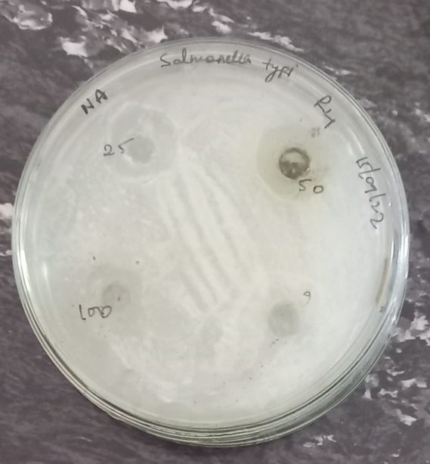
Salmonella typhi

Slide 13
CONCLUSION
Cissus quadrangularis is an indigenous medicinal plant of India and distributed throughout the tropical region in the world. It is known to be an ancient medicinal plant, with optimal healing in white tissue area of the body. In this study, the qualitative phytochemical and anti-bacterial properties of C.quadrangularis were evaluated. The qualitative phytochemical screening was evaluated by using ethanol extracts, and anti-bacterial activity of C.quadrangularis was studied against two pathogenic bacteria viz., S. aureus and S. typhi. The secondary metabolites such as alkaloids, saponins, phenols, tannins, terpenoids and flavonoids were present in ethanolic extract of C.quadrangularis. The antibacterial activity may be due to the presence of one or more chemical constituents present in the extract. The results claim that C. quadrangularis stem can be considered as a potential candidate for the development of novel antibacterial herbal formulation.

Slide 14
REFERENCE
1.Garima Mishra , Saurabh Srivastava , B.P.Nagori (2016) Pharmacological and Therapeutic Activity of Cissus quadrangularis International Journal of PharmTech Research CODEN (USA): IJPRIF ISSN : 0974-4304 Vol.2, No.2, pp 1298-1310,
2. Piyush S.BafnaaPayal H.PatilaSaurabh K.MarubRakesh E.Mutha(2021) Cissus quadrangularis L: A comprehensive multidisciplinary review Journal of Ethnopharmacology Volume 279,, 114355.
3. K.N. Chidambara Murthy A. Vanitha M. Mahadeva Swamy, and G.A. Ravishankar (2004) Antioxidant and Antimicrobial Activity of Cissus quadrangularis L. Journal of Medicinal FoodVol. 6, No. 2.
4. Sidney J. Stohs,Sidhartha D. Ray(2012) A Review and Evaluation of the Efficacy and Safety of Cissus quadrangularis Extracts phytotherapy research Volume27, Pp 1107-1114.
5.geetu singh, preeti rawat, rakesh mourya (2007) Constituents of Cissus quadrangularis Natural Product Research Formerly Natural Product Lettersn Volume 21, Pages 522-528.

